Slide 1

Caches III: Direct Mapped
Assistant
Teaching Professor
Lisa Yan
Slides: PDF

Slide 2
Line Replacement Policies

Slide 3
Fully Associative Cache with LRU policy
By the end of instr 5, cache is warm.
Load byte 0x43F 0x10F,0x3
Load byte 0x5E2 0x178,0x2
Load word 0x824 0x209,0x0
Load word 0x5E0 0x178,0x0
Load word 0x524 0x149,0x0
Load byte 0x972 0x25C,0x2
Valid | LRU | Tag | Data
 |  |  | 11 | 10 | 01 | 00
1 |  | 0x25C | … | … | … | …
1 |  | 0x178 | … | … | … | …
1 |  | 0x209 | … | … | … | …
1 |  | 0x149 | … | … | … | …
Valid | LRU | Tag
1 | 0 | 0x10F
0
0
0
Valid | LRU | Tag
1 | 1 | 0x10F
1 | 0 | 0x178
0
0
Valid | LRU | Tag
1 | 2 | 0x10F
1 | 1 | 0x178
1 | 0 | 0x209
0
Valid | LRU | Tag
1 | 2 | 0x10F
1 | 0 | 0x178
1 | 1 | 0x209
0
Valid | LRU | Tag
1 | 3 | 0x10F
1 | 1 | 0x178
1 | 2 | 0x209
1 | 0 | 0x149
Suppose that LRU = 0 means most recently used, and 3 means least recently used.
After the end of instruction 5, what are the LRU tags on each row?

Slide 4
A Warmed up Cache Can Still Miss
By the end of instr 5, cache is warm.
Load byte 0x43F 0x10F,0x3
Load byte 0x5E2 0x178,0x2
Load word 0x824 0x209,0x0
Load word 0x5E0 0x178,0x0
Load word 0x524 0x149,0x0
Load byte 0x972 0x25C,0x2
Valid | LRU | Tag | Data
 |  |  | 11 | 10 | 01 | 00
1 | 3 | 0x10F | … | … | … | …
1 | 1 | 0x178 | … | … | … | …
1 | 2 | 0x209 | … | … | … | …
1 | 0 | 0x149 | … | … | … | …
LRU | Tag
0 | 0x25C
2 | 0x178
3 | 0x209
1 | 0x149
… | … | … | …
Cache miss!
Load into cache the 4-byte line from 0x970 to 0x973. Mark valid bit. Update line replacement policy fields (e.g., LRU).r.
c. Read byte at 0x2 offset, return to processor.

Slide 5
Line Replacement Policies (i.e., Eviction)
Least Recently Used (LRU)
Replace the entry that has not been used for the longest time, i.e., has the oldest previous access.
Pro: Temporal locality!
recent past use implies likely future use
Con: Complicated hardware to keep track of access history
Most Recently Used (MRU)
Replace the entry that has the newest previous access.
First In, First Out (FIFO)
Replace the oldest line in the set (queue).
Last In, First Out (LIFO)
Replace the newest line in the set (stack).
Random
LRU is ideal for temporal locality. In practice, FIFO/LIFO/Random the most common.
Reasonable approximations to LRU, MRU without adding too much excess hardware.
Works surprisingly okay (when given a low temporal locality workload)

Slide 6
Write Policies

Slide 7
What about Stores?
By the end of instr 5, cache is warm.
Load byte 0x43F 0x10F,0x3
Load byte 0x5E2 0x178,0x2
Load word 0x824 0x209,0x0
Load word 0x5E0 0x178,0x0
Load word 0x524 0x149,0x0
Load byte 0x972 0x25C,0x2
Store byte 0x524 0x149,0x0
Valid | LRU | Tag | Data
 |  |  | 11 | 10 | 01 | 00
1 | 0 | 0x25C | … | … | … | …
1 | 2 | 0x178 | … | … | … | …
1 | 3 | 0x209 | … | … | … | …
1 | 1 | 0x149 | … | … | … | …
Cache hit! …and then?
How to handle stores?

Slide 8
Write-through vs. Write-back Policies
Store instructions write to memory, which changes values.
Hardware needs to ensure that cache and memory have consistent information.
Valid | LRU | Tag | Data
 |  |  | 11 | 10 | 01 | 00
1 | 0 | 0x25C | … | … | … | …
1 | 2 | 0x178 | … | … | … | …
1 | 3 | 0x209 | … | … | … | …
1 | 1 | 0x149 | … | … | … | …
Write policies have tradeoffs:
Store byte 0x524(0x149,0x0)
Write-through:
Write to the cache and memory at the same time.
(more writes to memory → longer AMAT)
Write-back:
Write data in cache and set a dirty bit to 1.
When this line gets evicted from the cache (and “back” to memory), write to memory.
simple to implement
(typically) lower traffic to memory

Slide 9
Fully Associative Cache w/ LRU, Write-Back
Write-back:
Write data in cache and set a dirty bit to 1.
When this line gets evicted from the cache (and “back” to memory), write to memory.
Valid | Dirty | LRU | Tag | Data
 |  |  |  | 11 | 10 | 01 | 00
1 | 0 | 0 | 0x25C | … | … | … | …
1 | 0 | 2 | 0x178 | … | … | … | …
1 | 0 | 3 | 0x209 | … | … | … | …
1 | 1 | 1 | 0x149 | … | … | … | …
Store byte 0x524(0x149,0x0)
Cache hit w/write-back:
update cache line, and wait until this line is evicted before writing back to memory

Slide 10
Direct Mapped Cache

Slide 11
Cache Design: Placement Policies
Fully Associative Cache
Put a new line anywhere
(Caches II)
Direct Mapped Cache
Put a new line in one specific place
(Caches III, today)
Set-Associative Cache
(Caches IV)
Fully associative caches need expensive hardware.

Slide 12
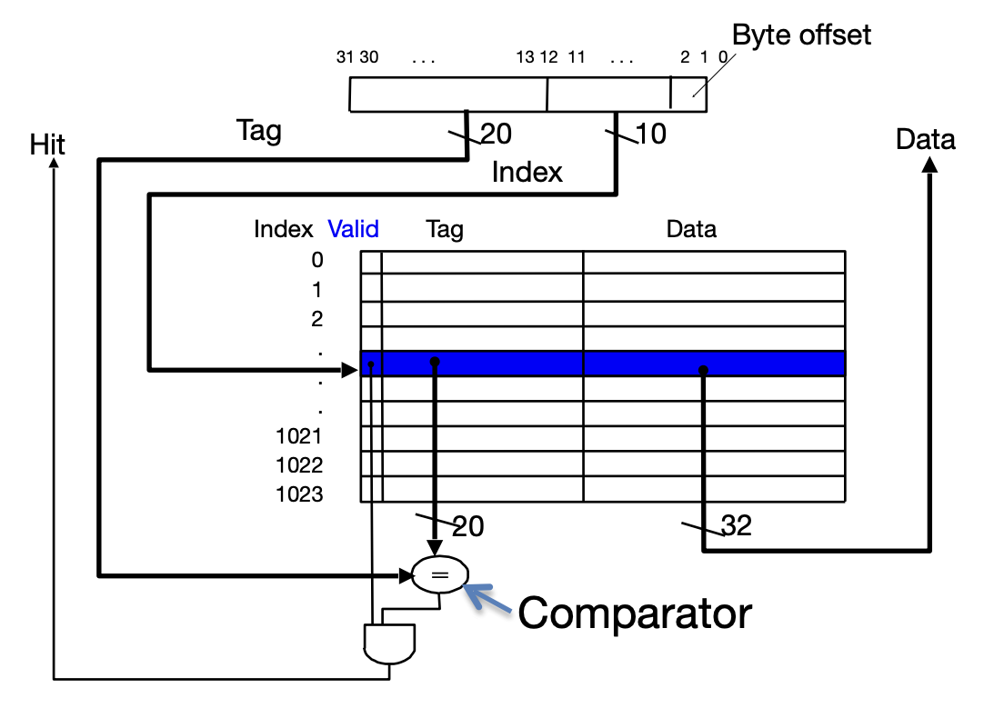
Hardware: Direct Mapped Cache
(more later)
Much simpler to implement than Fully Associative! Just check one tag/line, and not all lines.

Slide 13
Direct Mapped Cache
Placement policy: Each memory address is associated with exactly one possible line in the cache.
To check for existence in the cache, we only need to look in a single location in the cache.
flags |  | Tag | Data
 |  |  | 11 | 10 | 01 | 00
… |  | … | … | … | … | …
… |  | … | … | … | … | …
… |  | … | … | … | … | …
… |  | … | … | … | … | …
How do we ensure this?

Slide 14
Direct Mapped Cache
Placement policy: Each memory address is associated with exactly one possible line in the cache.
To check for existence in the cache, we only need to look in a single location in the cache.
flags |  | Tag | Data
 |  |  | 11 | 10 | 01 | 00
… | … | … | … | … | … | …
… | … | … | … | … | … | …
… | … | … | … | … | … | …
… | … | … | … | … | … | …
31 |  | 0
Full 32b address
tag | index | offset
tag to connect line to memory address
index to select line in cache
byte offset within line

Slide 15
Direct Mapped Caches: 4B Cache
flags |  | Tag | Data
… | … | … | …
… | … | … | …
… | … | … | …
… | … | … | …
4B Direct Mapped Cache (line size 1B)
Line starting… maps to… has tag…
@ 0x0 index 0 000000
@ 0x1 index 1 000000
@ 0x2 index 2 000000
@ 0x3 index 3 000000
Different addresses get same line index but different tags.
Tag: 000000
000001
(assume 8b address)
0x
0 | 1 | 2 | 3 | 4 | 5 | 6 | 7 | 8 | 9 | A | B | C | D | E | F | 10 | 11 | 12 | 13 | 14 | 15 | 16 | 17 | 18 | 19 | 1A | 1B | 1C | 1D | 1E | 1F

Slide 16
Direct Mapped Caches: 4B Cache
flags |  | Tag | Data
… | … | … | …
… | … | … | …
… | … | … | …
… | … | … | …
4B Direct Mapped Cache (line size 1B)
Line starting… maps to… has tag…
@ 0x0 index 0 000000
@ 0x1 index 1 000000
@ 0x2 index 2 000000
@ 0x3 index 3 000000
@ 0x4 index 0 000001
@ 0x8 index 0 000010
@ 0xC index 0 000011
etc.
Lines with same line index evict each other.
0x
0 | 1 | 2 | 3 | 4 | 5 | 6 | 7 | 8 | 9 | A | B | C | D | E | F | 10 | 11 | 12 | 13 | 14 | 15 | 16 | 17 | 18 | 19 | 1A | 1B | 1C | 1D | 1E | 1F

Slide 17
Direct Mapped Caches: 8B Cache
flags |  | Tag | Data
 |  |  | 1 | 0
… | … | … | … | …
… | … | … | … | …
… | … | … | … | …
… | … | … | … | …
8B Direct Mapped Cache (line size 2B)
Line starting… maps to… has tag…
@ 0x0 index 0 00000
@ 0x2 index 1 00000
@ 0x4 index 2 00000
@ 0x6 index 3 00000
@ 0x8 index 0 00001
@ 0x10 index 0 00010
@ 0x18 index 0 00011
etc.
Tag: 000000
0x
0 | 1 | 2 | 3 | 4 | 5 | 6 | 7 | 8 | 9 | A | B | C | D | E | F | 10 | 11 | 12 | 13 | 14 | 15 | 16 | 17 | 18 | 19 | 1A | 1B | 1C | 1D | 1E | 1F

Slide 18
Direct Mapped Caches: 16B Cache
flags |  | Tag | Data
 |  |  | 11 | 10 | 01 | 00
… | … | … | … | … | … | …
… | … | … | … | … | … | …
… | … | … | … | … | … | …
… | … | … | … | … | … | …
16B Direct Mapped Cache (line size 4B)
Line starting… maps to… has tag…
@ 0x0 index 0 00000
@ 0x4 index 1 00000
@ 0x8 index 2 00000
@ 0xC index 3 00000
@ 0x10 index 0 00001
etc.
Tag: 000000
0x
0 | 1 | 2 | 3 | 4 | 5 | 6 | 7 | 8 | 9 | A | B | C | D | E | F | 10 | 11 | 12 | 13 | 14 | 15 | 16 | 17 | 18 | 19 | 1A | 1B | 1C | 1D | 1E | 1F

Slide 19
Direct Mapped Cache
Placement policy: Each memory address is associated with exactly one possible line in the cache.
To check for existence in the cache, we only need to look in a single location in the cache.
flags |  | Tag | Data
 |  |  | 11 | 10 | 01 | 00
… | … | … | … | … | … | …
… | … | … | … | … | … | …
… | … | … | … | … | … | …
… | … | … | … | … | … | …
31 |  | 0
Full 32b address
tag | index | offset
Unlike FA caches, DM caches have an index to identify the only cache line for this memory address.
tag to connect line to memory address
index to select line in cache
byte offset within line

Slide 20
Fill in the blank: Direct Mapped, 12b addresses
Suppose we have the below direct mapped cache for 12b addresses.
A. B. C. D. E. F.
2 4 8 10 16 Other
2 4 8 10 16 Other
2 4 8 10 16 Other
2 4 8 10 16 Other
What is the line size / block size, in bytes?
What is the capacity, in bytes?
For a 12b address, how many bits is the byte offset?
For a 12b address, how many bits is the index?
For a 12b address, how many bits is the tag?
flags | Tag | Data
 |  | 11 | 10 | 01 | 00

Slide 21
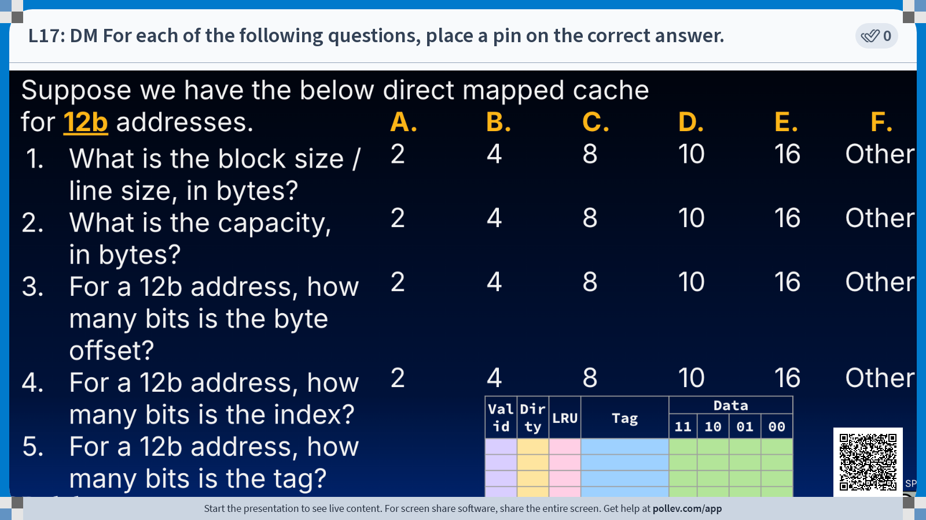

Slide 22
Terminology for Direct Mapped, 12b addresses
1. Line size / block size:
# bytes per cache line
2. Capacity
Total # data bytes that can be stored in a cache
3. Offset
Identifies byte address of data stored at a given cache line
4. Index
Selects cache line
5. Tag
Identifies data stored at a given cache line to a given memory address
Tag | Data
 | 11 | 10 | 01 | 00
4 bytes
4 x 4 bytes
= 16 bytes
log₂(line size) = 2 bits
memory address
11 4 | 3 2 | 1 0
log₂(# lines) = 2 bits
tag
offset
index
# address bits - # offset bits - # index bits = 8 bits

Slide 23
Direct Mapped Cache Analysis

Slide 24
Example: Direct Mapped Cache
Suppose we have the following direct mapped cache, for 12b addresses.
Load byte 0xFE2
valid | dirty | Tag | Data
 |  |  | 11 | 10 | 01 | 00
0 | … | … | … | … | … | …
0 | … | … | … | … | … | …
0 | … | … | … | … | … | …
0 | … | … | … | … | … | …
1 | 0 | 0xFE | … | … | … | …
Compute T/I/O
memory address
0b1111 1110 0010
tag
0xFE
index
0x0
offset
0x2
11 4 | 3 2 | 1 0
tag
offset
index

Slide 25
Warming up the Direct Mapped Cache (2/6)
Suppose we have the following direct mapped cache, for 12b addresses.
Load byte 0xFE2 0xFE,0x0,0x2
valid | dirty | Tag | Data
 |  |  | 11 | 10 | 01 | 00
0 | … | … | … | … | … | …
0 | … | … | … | … | … | …
0 | … | … | … | … | … | …
0 | … | … | … | … | … | …
1 | 0 | 0xFE | … | … | … | …
0b1111 1110 0010
tag
index
offset
Cache miss! Tag 0xFE is not valid.
0b1111 1110 0000 ← 0xFE0
0b1111 1110 0011 ← 0xFE3
b. Load into cache the 4-byte line from 0xFE0 to 0xFE3. Mark valid bit.
c. Read byte at 0x2 offset and return to processor.

Slide 26
Direct Mapped: Policies
What policies can be implemented for a direct-mapped cache?
Select all that apply.
1. Write Policy
A. Write-through (memory access per write)
B. Write-back (dirty bit, write to memory on eviction)
2. Line Replacement (Eviction) Policy
A. Least Recently Used
B. Most Recently Used
C. FIFO
D. Random
E. None of the Above

Slide 27
Direct Mapped: Policies Solution
What policies can be implemented for a direct-mapped cache?
Select all that apply.
1. Write Policy
A. Write-through (memory access per write)
B. Write-back (dirty bit, write to memory on eviction)
2. Line Replacement (Eviction) Policy
A. Least Recently Used
B. Most Recently Used
C. FIFO
D. Random
E. None of the Above
In direct mapped caches, there is only ever one line to evict—the existing line with matching index.

Slide 28
Types of Misses

Slide 29
Types of Misses
Compulsory Miss
Caused by the first access to a line that has never been in the cache
Capacity Miss
Caused when the cache cannot contain all the lines needed during the execution of a program
Occur when lines were in the cache, replaced, and later retrieved
Conflict Miss
Multiple lines compete for the same location in the cache, even when the cache has not reached full capacity.
In this class, we will only distinguish between compulsory and non-compulsory misses.
“Non-compulsory” miss

Slide 30
Types of Misses
Compulsory Miss
Caused by the first access to a line that has never been in the cache
Capacity Miss
Caused when the cache cannot contain all the lines needed during the execution of a program
Occur when lines were in the cache, replaced, and later retrieved
Conflict Miss
Multiple lines compete for the same location in the cache, even when the cache has not reached full capacity.
Which types of misses can occur for Fully Associative caches (FA)? For Direct Mapped caches (DM)?
Select all that apply.
A. FA: Compulsory
B. DM: Compulsory
C. FA: Capacity
D. DM: Capacity
E. FA: Conflict
F. DM: Conflict
G. None of the above

Slide 31
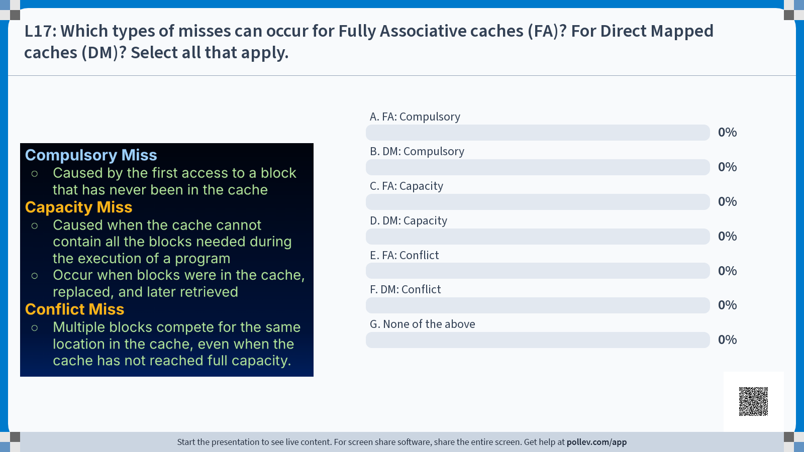

Slide 32
Types of Misses
Compulsory Miss
Caused by the first access to a line that has never been in the cache
Capacity Miss
Caused when the cache cannot contain all the lines needed during the execution of a program
Occur when lines were in the cache, replaced, and later retrieved
Conflict Miss
Multiple lines compete for the same location in the cache, even when the cache has not reached full capacity.
Which types of misses can occur for Fully Associative caches (FA)? For Direct Mapped caches (DM)?
Select all that apply.
A. FA: Compulsory
B. DM: Compulsory
C. FA: Capacity
D. DM: Capacity
E. FA: Conflict
F. DM: Conflict
G. None of the above

Slide 33
Types of Misses
Compulsory Miss
Caused by the first access to a line that has never been in the cache
Capacity Miss
Caused when the cache cannot contain all the lines needed during the execution of a program
Occur when lines were in the cache, replaced, and later retrieved
Conflict Miss
Multiple lines compete for the same location in the cache, even when the cache has not reached full capacity.
In this class, we will only distinguish between compulsory and non-compulsory misses.
Occurs in direct mapped caches, as well as set associative caches (more later).
Misses of this type would not occurring a fully associative cache with similar specs.

Slide 34
How to categorize misses
[reference]
Run an address trace against a set of caches.
(thanks Prof. Kubiatowicz for the algorithm).
First, consider an infinite-size, fully-associative cache. For every miss that occurs now, consider it a compulsory miss.
Next, consider a finite-sized cache (of the size you want to examine) with full-associativity. Every miss that is not in #1 is a capacity miss.
Finally, consider a finite-size cache with finite-associativity. All of the remaining misses that are not #1 or #2 are conflict misses.
In this class, we will only distinguish between compulsory and non-compulsory misses.

Slide 35
Cache Design: Placement Policies, Summary
Fully Associative
Placement policy: Data at any memory address can be associated with any cache line
Expensive hardware: check all lines
Write policies: write-back, write-through
Must decide eviction policy (LRU, MRU, FIFO, etc.)
Direct Mapped
Placement policy: Each memory address is associated with exactly one possible line in the cache.
Simpler hardware: check one line
Write policies: write-back, write-through
No eviction policy, because we know which line to replace
Has conflict misses
For the above reasons, smaller/lower level caches are generally fully associative.

Slide 36
Cache Design: Placement Policies, Next Time
Fully Associative Cache
Put a new line anywhere
(Caches II)
Direct Mapped Cache
Put a new line in one specific place
(Caches III, today)
Set-Associative Cache
Something in-between (how?)
(Caches IV)

